Slide 1


Car Audio Safety Alert System
The FOUR Horsepower
Anant Vedansh
Viswa Harsha C
Rohan N Kalpavruksha
Altaf Kandagal
HACK
2023

Slide 2
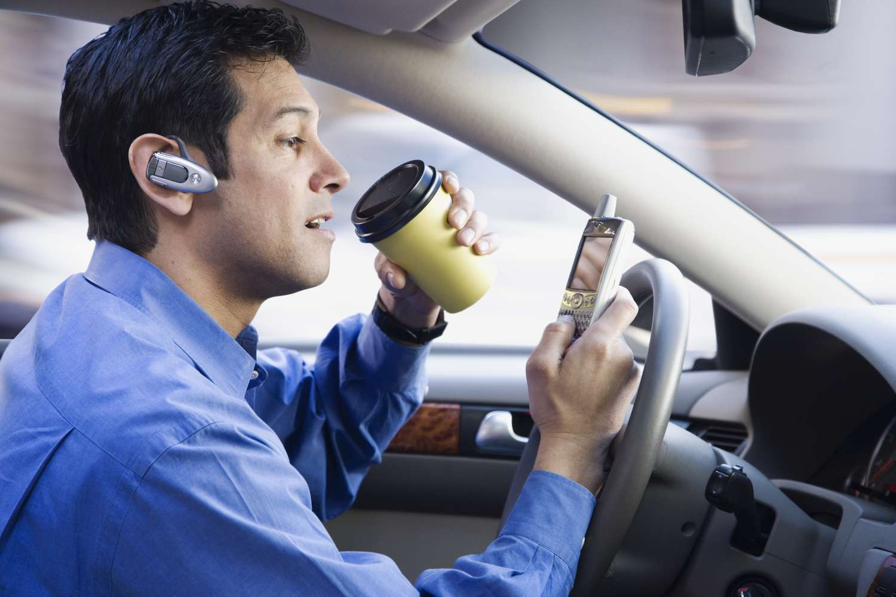
Problem Statement
1
Loud Music System
Distraction and inaudibility due to loud music through entertainment system.
Driving on busy roads can be a challenging task, along with internal noise, loud music systems or any similar factors, it becomes difficult to hear external sounds such as car horns or emergency sirens.
2
Customers with Hearing Disability
Catering to the needs and safety of customers with special needs in terms of hearing ability.
3
General Distractions
Reduced attention to sound alerts over general distractions while driving.

Slide 3
Metrics
Every year, on an average 20 - 30 percent patients die due to delay in getting medical help as ambulances are delayed due to traffic.

Slide 4
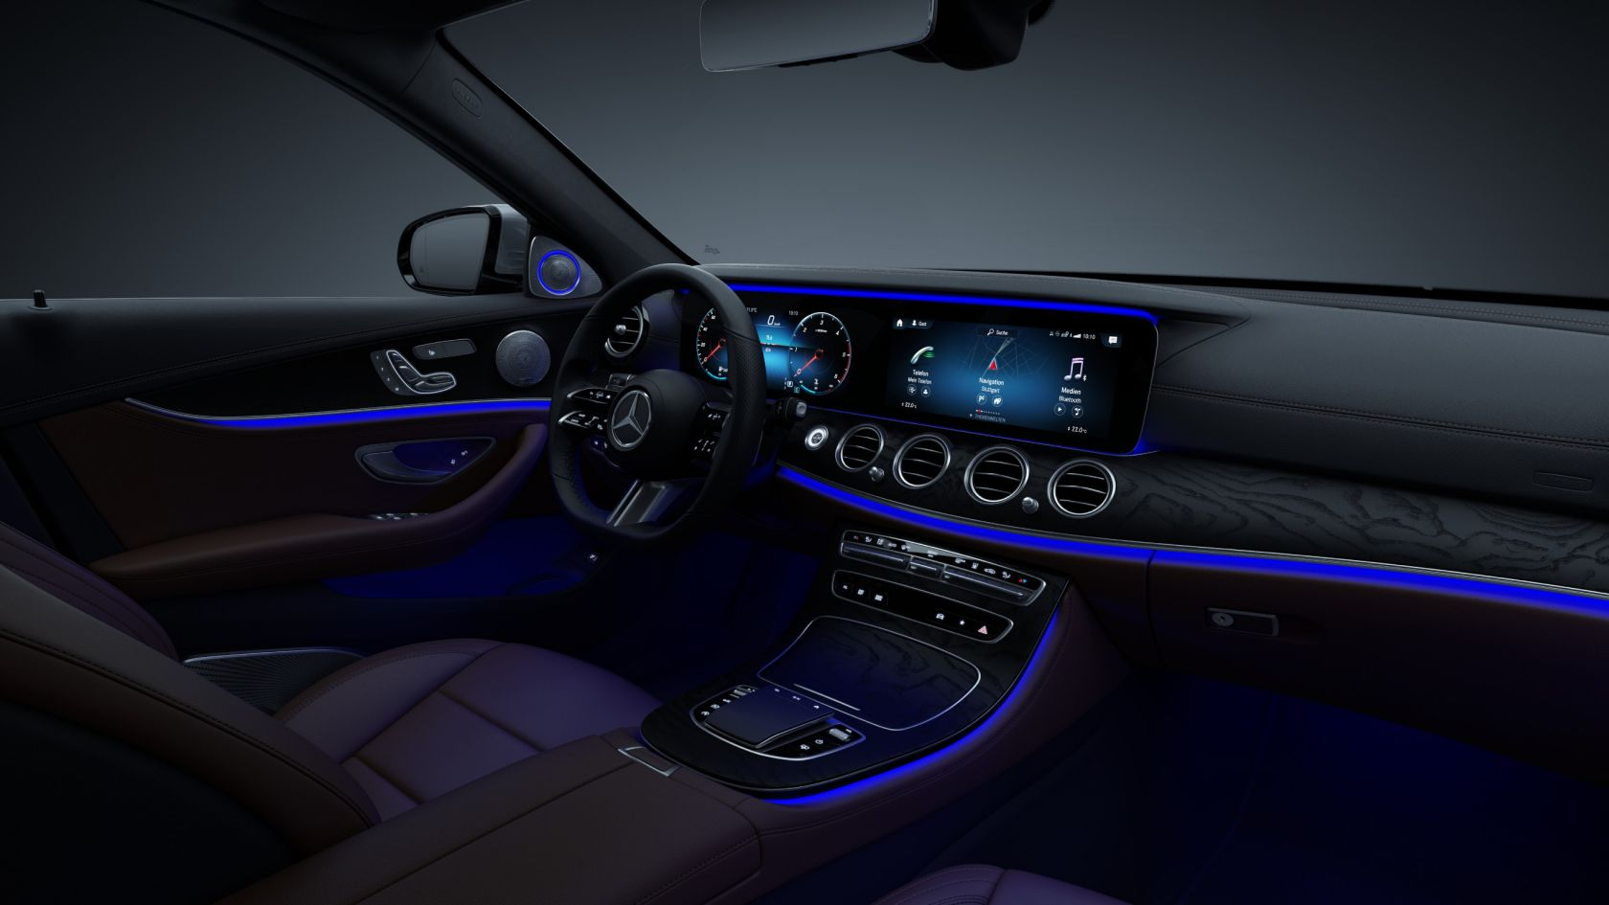
The Solution
Notify the driver by:
1
A driver alert system to notify the driver in real time about high priority sound alerts by detecting external sounds around the car, such as horns and sirens.
Ambient Light Alert
Alert the driver with a immediate change in the interior ambient lighting color.
2
HU Notification
Driver side HU notification for continuous car honks
3
Haptic Steering Feedback
Vibrating steering wheel for high priority external siren sounds.

Slide 5

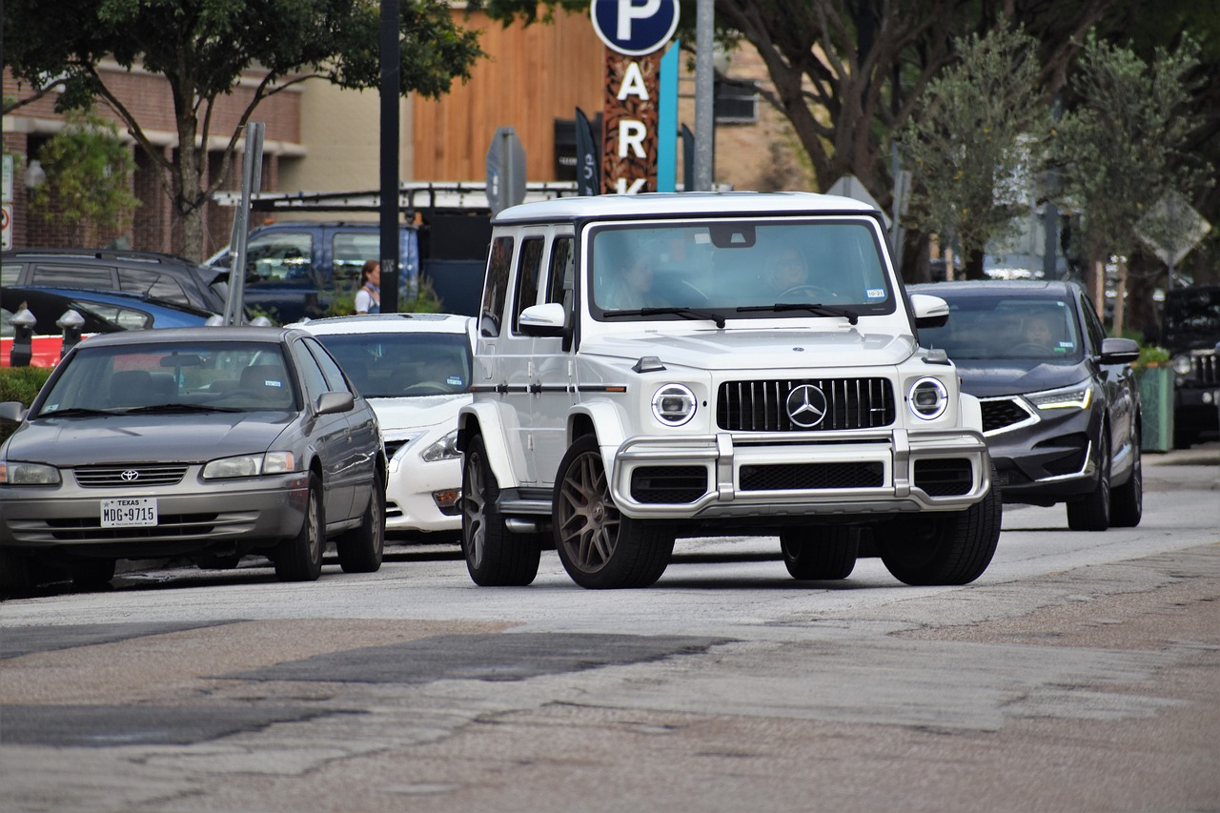

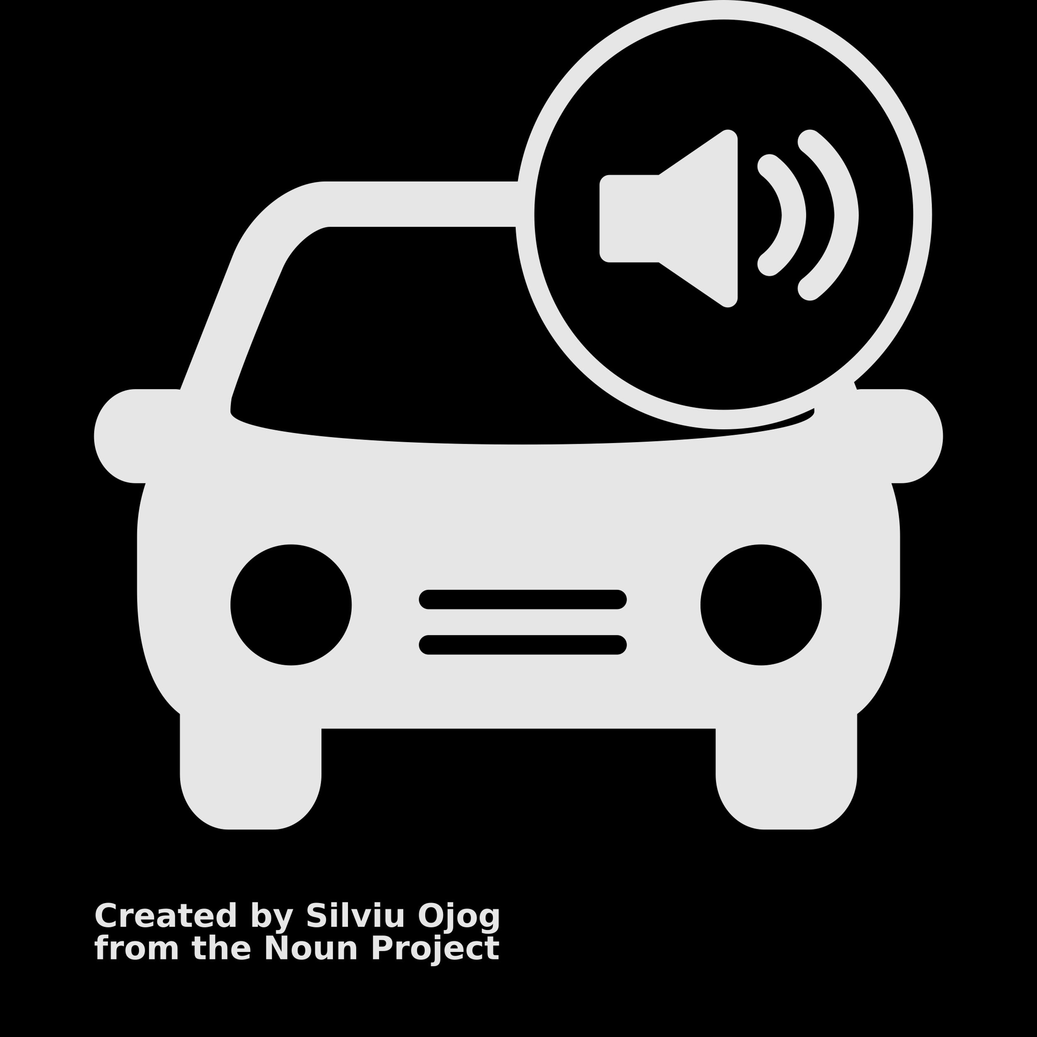
Primary Use Cases
Priority based detection and alert classification
Emergency Vehicles
Car
Honking

Slide 6














Workflow
Acquisition of training data
Feature Extraction
Training and Refinement
Interfacing with hardware
Microphone
Prepocessing
Feature Extraction
Classification
Decision
Automotive onboard microphone
Filtering and amplification of acoustic signal
Spectral analysis and normalization
Using a Neural Network
Siren or Car Horn

Slide 7
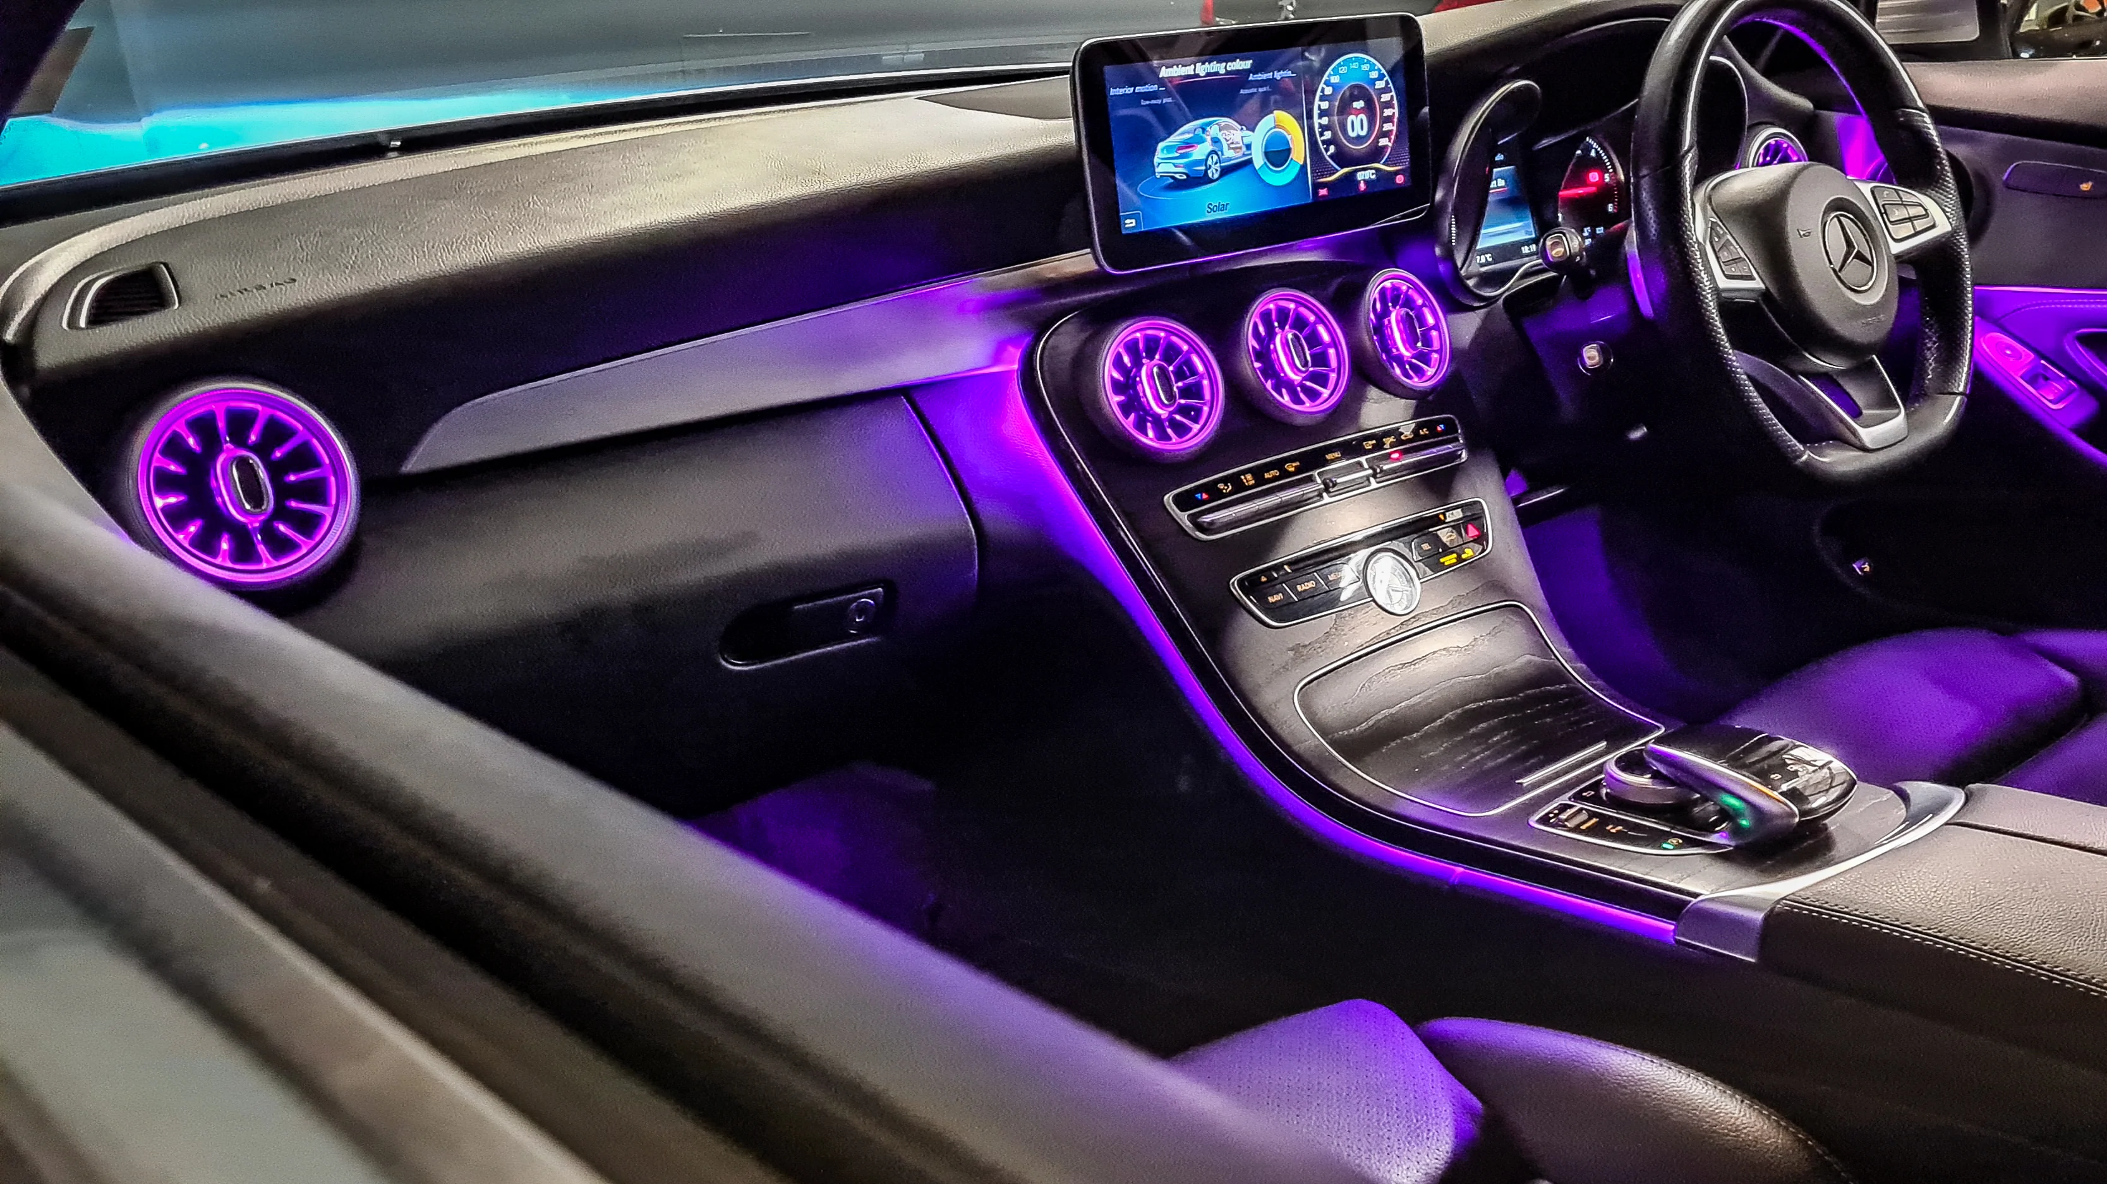
Demo

Slide 8
Q&A
Thank You

